Slide 1
TinHat Random crypto random for the truly paranoid https://tinhatrandom.org
Copyright ©2014 Concept Blossom, Inc

Slide 2
“Typically it is the random number generators that are attacked as opposed to the encryption algorithms themselves.”
- Ed Snowden, 2014

Slide 3
Case Study: One-Time Pad (OTP)
Plaintext: 0110 0011 0110 0001 0111 0100
Random Key: 1011 1111 0100 0011 1010 1010
XOR (Ciphertext): 1101 1100 0010 0010 1101 1110
Plaintext is easily recoverable as long as you know the key
XOR is easily reversible
Ciphertext is indistinguishable from pure random
(Unless Plaintext related to Key)

Slide 4
Bad Random in the wild
>60% of hosts in the wild serve non-unique public keys
TLS default certificates: 5%
Low entropy / repeated keys: 0.3%
SSH default or low entropy keys: 10%
Weak DSA keys: 0.5% of TLS, and 1% of SSH hosts
Juniper, Cisco, IBM, Intel… Major manufacturers Reference: “Mining Your Ps and Qs, Detection of Widespread Weak Keys in Embedded Devices” Feb 26, 2012 https://www.rsaconference.com/writable/presentations/file_upload/cryp-t17.pdf

Slide 5
Stealthy Dopant-Level Hardware Trojans
“Our Trojan is capable of reducing the security of the produced random number from 128 bits to n bits, where n can be chosen. Despite these changes, the modified Trojan RNG passes not only the Built-In-Self-Test (BIST) but also generates random numbers that pass the NIST test suite for random numbers.”
https://www.schneier.com/blog/archives/2013/09/surreptitiously.html (Original web link broken)

Slide 6
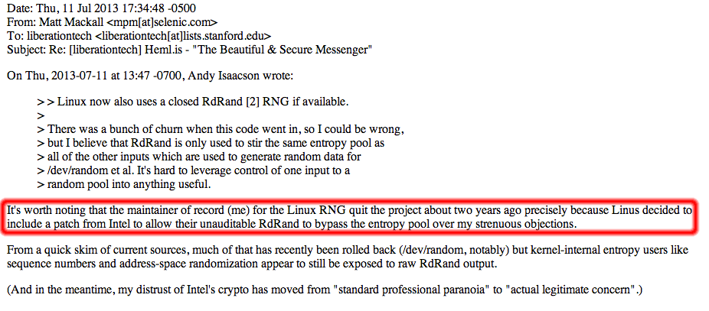
Linux Kernel

Slide 7
BouncyCastle
~20,000 downloads per month
In java, SecureRandom() is a wrapper around the OS crypto random API
SecureRandom() is used EVERYWHERE
When porting to C#, in bc-csharp, SecureRandom() had to be created
Did not simply create a wrapper around RNGCryptoServiceProvider()

Slide 8



BouncyCastle

Slide 9
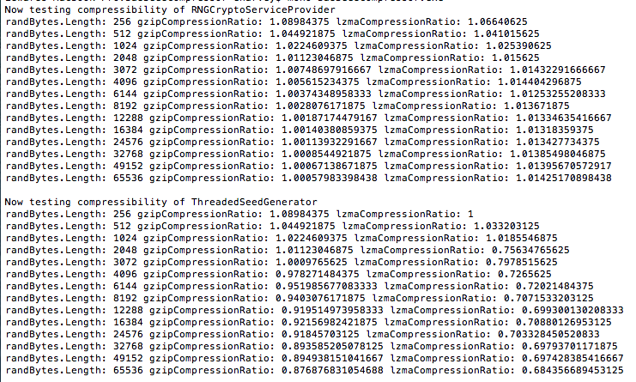
BouncyCastle

Slide 10
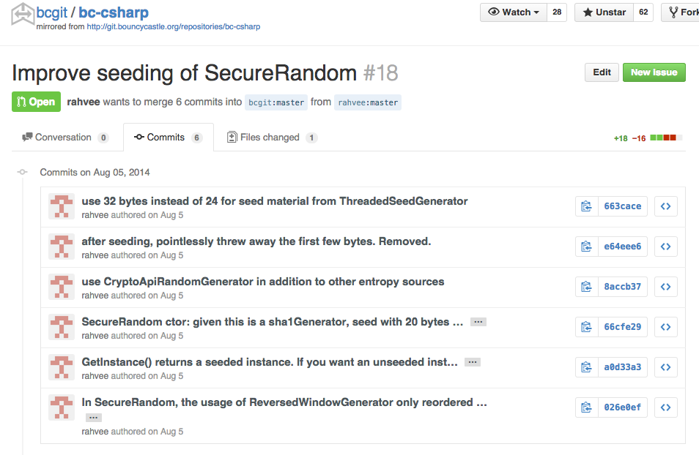
BouncyCastle patch submitted

Slide 11
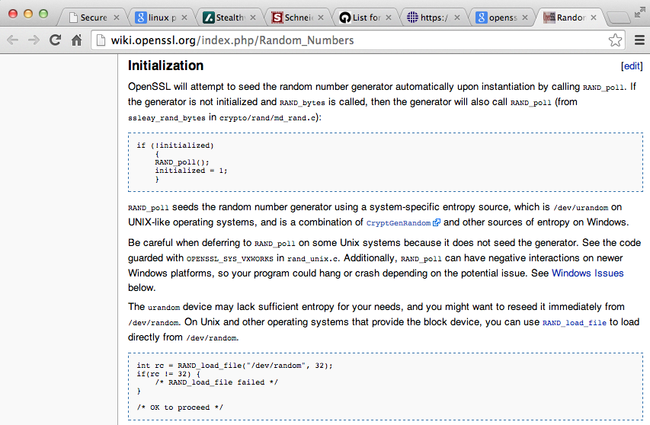
OpenSSL
Basically, it just says that it uses the OS random provider, and it is fraught with peril.

Slide 12
First Attempt: Secure Random based on OTP
Random Plaintext A: 0100 1111 1000 1011 1111 0001
Random Key B: 1011 1111 0100 0011 1010 1010
XOR (Ciphertext) C: 1111 0000 1100 1000 0101 1011
Possible Malicious Behavior:
Insufficient Entropy (lying about entropy source spec)
Chosen Plaintext or chosen Key
Specifically, there are two possible attack cases:
Exact match (trivially detected)
Different but related
Record and/or Transmit

Slide 13
Countermeasures
Insufficient Entropy (lying about entropy source spec)
Mix in more entropy sources
Chosen Plaintext or chosen Key
Exact match (trivially detected)
Detect and Discard
Different but related
More discussion, next slides…
Record and/or Transmit
Acknowledged. No Defense.

Slide 14
Cryptographic Hash
Collision Resistance
Cannot manipulate input to have a controlled effect on the output
Any manipulation of input results in effectively random results on the output

Slide 15
Countermeasure to Different But Related:
Random A: 0100 1111 1000 1011 1111 0001
Random B: 0100 1011 1000 1011 1111 0001
Hash A’: 0011 0101 0001 1011 1110 0011
Hash B’: 0111 1100 0111 1000 0111 1100
XOR (Ciphertext): 0100 1001 0110 0011 1001 1111
We destroyed any possibility for any (malicious) relationship between A and B to have any non-random influence of the output.

Slide 16
Core Concept behind TinHat Random
Random A: 0100 1111 1000 1011 1111 0001
Random B: 1000 1101 0101 1101 1010 1110
Random C: 0010 0101 1110 0110 0000 1101
Random D: 1101 1101 1011 0001 0011 1100
Hash A’: 0010 0111 1110 0010 0110 1101
Hash B’: 0011 1000 0111 1010 1100 0101
Hash C’: 1100 1111 0111 0000 0011 1010
Hash D’: 1111 1110 1010 1100 1000 1000
XOR (Ciphertext): 0100 1001 0110 0011 1001 1111

Slide 17
TinHat Defaults
TinHat default constructors use:
SystemRNGCryptoServiceProvider/SHA256
ThreadedSeedGeneratorRNG/SHA256/RipeMD256Digest
ThreadSchedulerRNG/SHA256
(if available) EntropyFileRNG/SHA256

Slide 18
TinHat Random API
using tinhat;
TinHatRandom.StaticInstance.GetBytes(byte[] buf)
TinHatURandom.StaticInstance.GetBytes(byte[] buf)
EntropySources.EntropyFileRNG.AddSeedMaterial(byte[] buf)
// Start gathering entropy as early as possible) StartEarly.StartFillingEntropyPools();

Slide 19
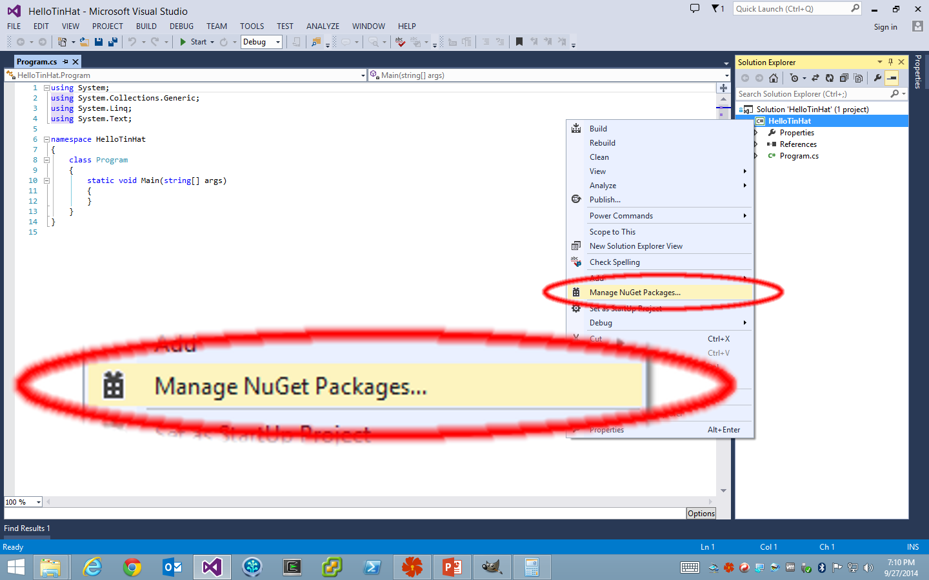

Slide 20
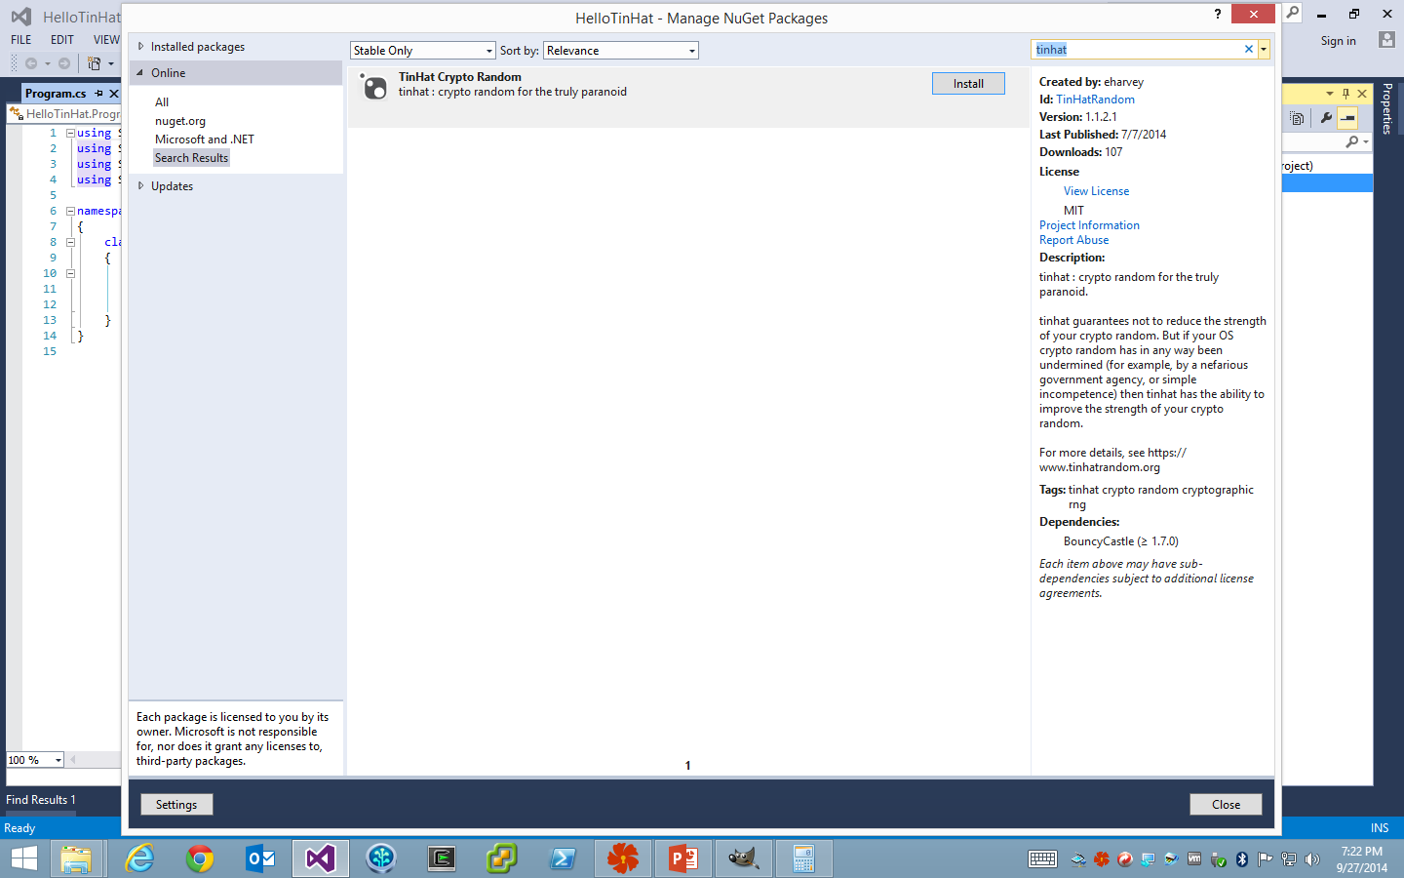

Slide 21
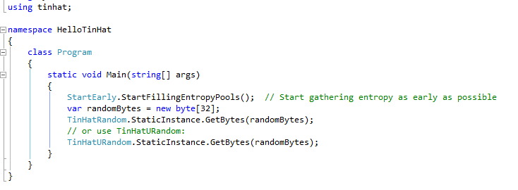

Slide 22
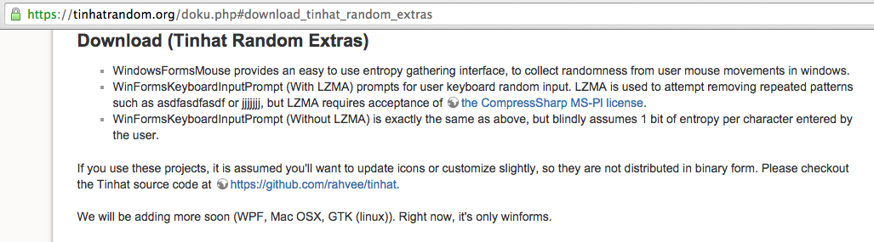

Slide 23
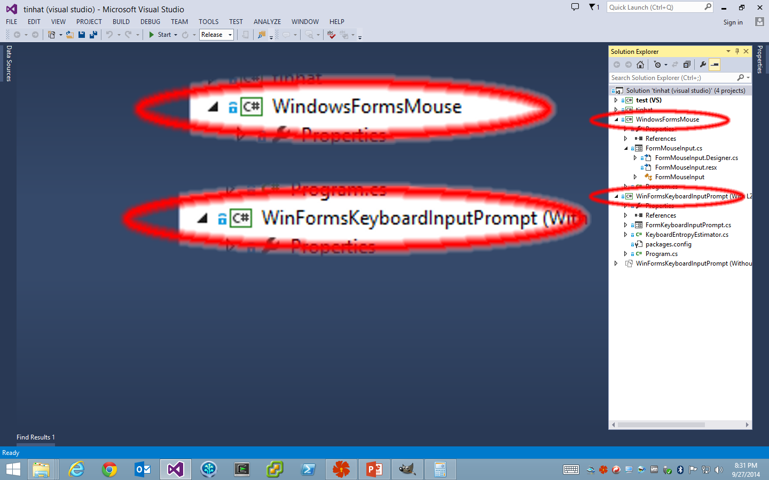

Slide 24
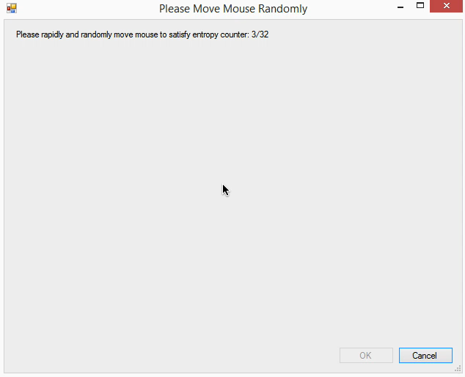

Slide 25
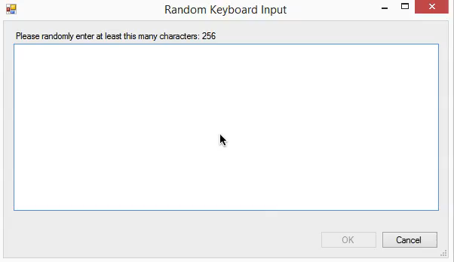

Slide 26
Fin

